Slide 1

Postprandial Metabolomics
CDT Ireland McCauley​
Advisor(s): COL Andrew Lee and CPT Brad Dinkel​
​
Date: 03DEC2025

Slide 2
Background
People spend most of their lives in a postprandial state
  Nutrient intake shapes metabolic reactions and overall health
Postprandial glucose responses vary widely between individuals and are strongly linked to cardiometabolic disease risk
  Prediabetes, type II diabetes, cardiovascular diseases
Traditional approaches fail to explain this variation
  Calorie counting, carb counting, “one diet fits all” approach
Large-scale studies (NPH) investigate how diet, gut microbiome, personal health factors, and genetics influence metabolic responses
  Metabolomics research shows that meal composition creates distinct temporal metabolic patterns across hundreds of metabolites

Slide 3
Purpose and Motivation
Motivation
Machine learning models have shown success in predicting personalized metabolic responses when incorporating individual factors (gut microbiome, clinical data, metabolites)
My dataset (Weinisch et al.) provides an ideal foundation of 600+ metabolites, glucose, insulin, and three dietary challenge types with clear postprandial patterns
Purpose
Use metabolite time-series trajectories across different meal challenges alone to predict glucose using a machine learning model
  Linear Mixed Effects + False Discovery Rate
  Ultimate Objective
    Support precision nutrition strategies by identifying how metabolic profiles can personalize dietary recommendations to help prevent negative glycemic responses

Slide 4
Data Overview
9 samples every 15 minutes for the OGTT
7 samples every 30 minutes for OLTT
5 samples every 60 minutes for SLD
The Participants
15 healthy male participants were recruited to be as homogeneous as possible
Average age of 27.8 ± 2.9 years
Normal weight [body mass index (BMI) of 23.1 ± 1.8 kg/m²]
Participants did not take any medication, and none of the participants showed any metabolic abnormalities according to standard clinical chemistry

Slide 5
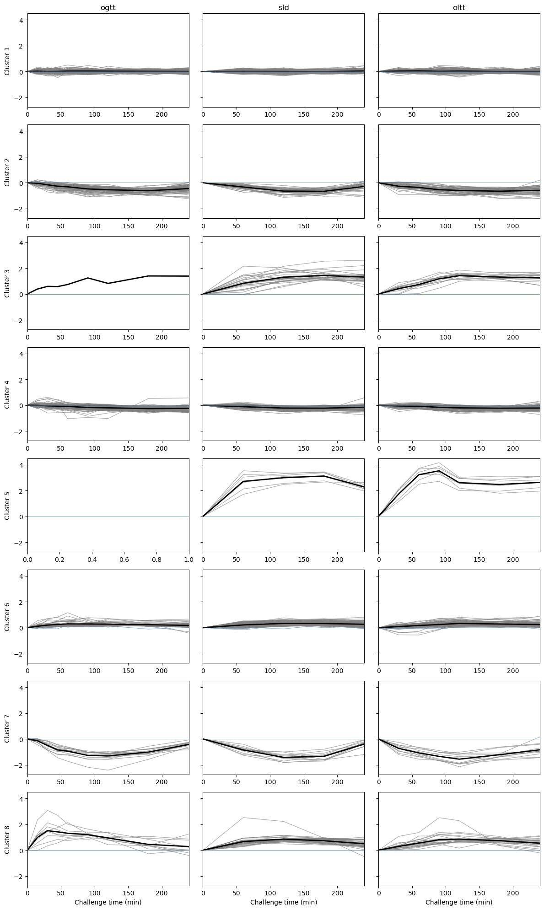
Clustering
K-means Clustering with 8 clusters
Average log2 fold change for each metabolite
Standardized (mean 0 STD 1)
0, 60, 120, 180, 240 minutes
Findings demonstrate challenge specific metabolic responses

Slide 6
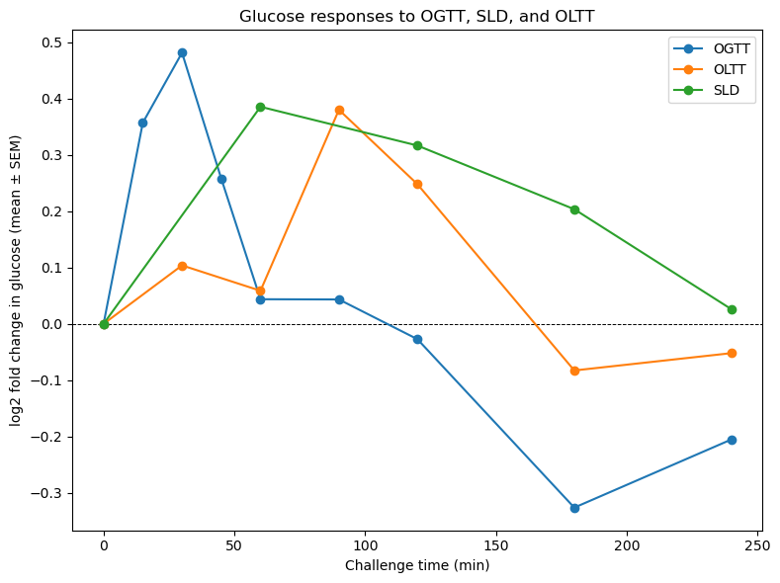
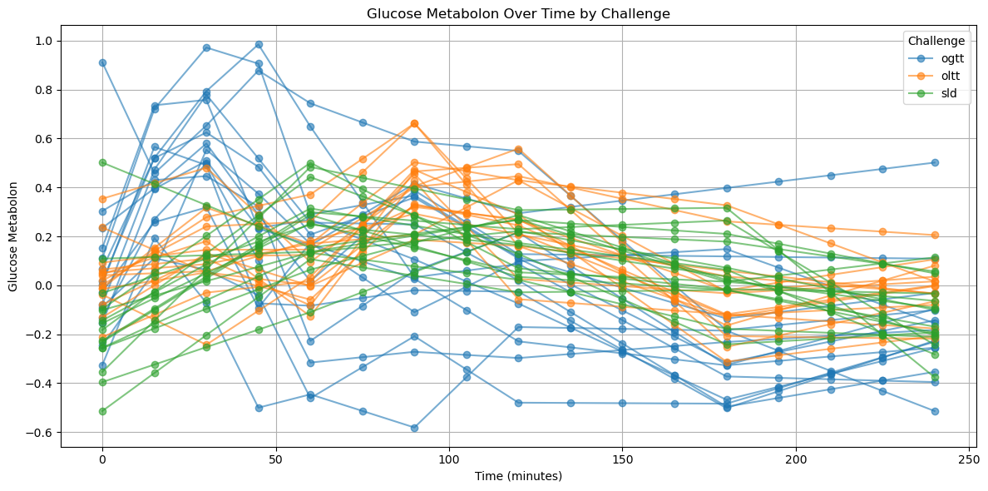
Glucose Analysis
Average log2 Fold Change for Glucose by Test
Raw Glucose Values for each subject with linear interpolation

Slide 7
LME + FDR Model
Step 1: Feature Selection Using FDR
  For each metabolite:
    Fit a LME to test its association with glucose
    Extract p-values →use Benjamini–Hochberg FDR to keep only significant metabolites
  Testing Different FDR Thresholds
    Tested models with different numbers of top features
    21 features performed best
Step 2: Build the Main Mixed-Effects Model
  Fixed Effects
    Time
    Challenge type
    Selected metabolites
    Time × Challenge interaction
  Random Effects
    Subject-specific intercepts
    Subject-specific time slopes
Handles repeated-measures
Captures subject-specific patterns
Allows time × challenge interactions
Works with high-dimensional metabolites via FDR

Slide 8
LME + FDR Model
Step 3 : Cross-Validation (Leave-One-Subject-Out)
  On each fold →train on 14 subjects
  Predict glucose curve for the held-out subject
  Compute out-of-fold R²
Step 4: Sensitivity
  Refit the model without random time slopes to test whether our results depended on allowing participant-specific time trajectories
    R² drops from 58.55% → 49.99%
    Allowing each subject their own time slope significantly improves predictions
    Individual differences are not just baseline shifts → people react to meals differently over time
    Subject-specific metabolism is a crucial part of accurate prediction

Slide 9
Findings
Results (Out-of-Fold R²):
Metabolites extracted in $\frac{x}{15}$ subjects
# Metabolites | R² (%)
3 | 55.75%
5 | 50.99%
10 | 48.47%
15 | 50.76%
21 (best) | 58.55%
Gluconate → 15/15
Fructose → 15/15
Glutamate → 15/15
Insulin → 15/15
Phosphoethanolamine → 14/15
Pyruvate → 12/15
Glycerate → 11/15
Palmitoylcholine → 9/15
Orotate → 9/15
Phosphate → 9/15

Slide 10
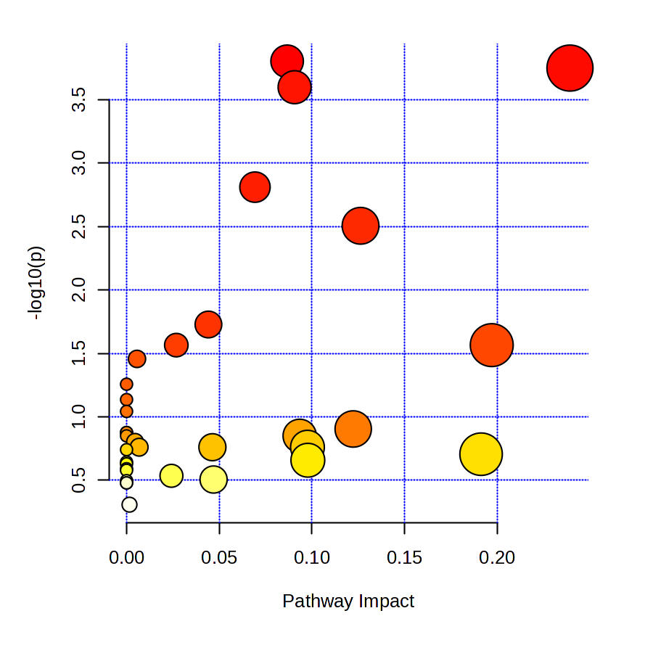
Metabolic Pathways
X-axis & Bubble Size
  Pathway Impact
  Shows how much the pathway is affected
    Further right → that pathway plays a larger role in the body’s response
Y-axis & Color
  −log10 p-value
  Shows statistical significance
    How strong the evidence is that the pathway is important
Bubble Size
  How many metabolites belong to that pathway

Slide 11
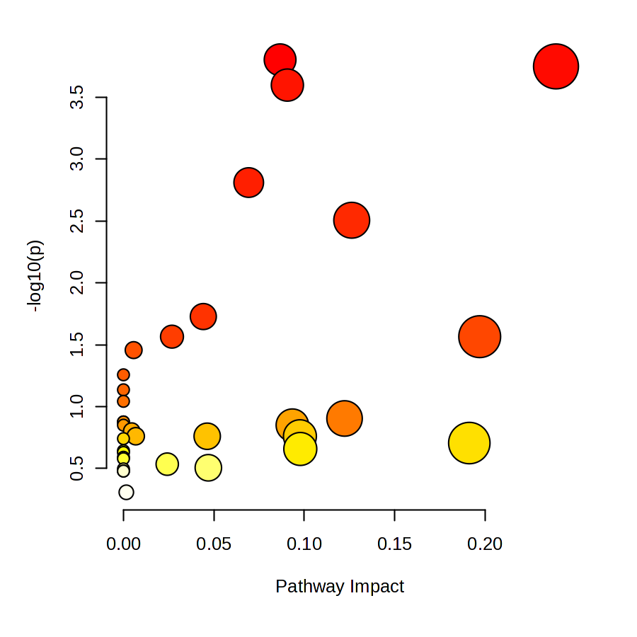
Pathway Analysis
Pathways in the upper right are the ones most effected by the metabolites contributing to glucose prediction.
  Pathways most tied to postprandial glycemic regulation
Glyoxylate and dicarboxylate metabolism
Glycine, serine and threonine metabolism
Arginine and proline metabolism
One carbon pool by folate
Cysteine and methionine metabolism
Alanine, aspartate and glutamate metabolism

